Slide 1
HAML: Heterogenous Computing for Machine Learning Algorithms
Santiago Campoverde, Jonathan Tan, Joshua Czarniak, Justin Wenzel, Kai Heng Gan
Notes:
Everyone

Slide 2
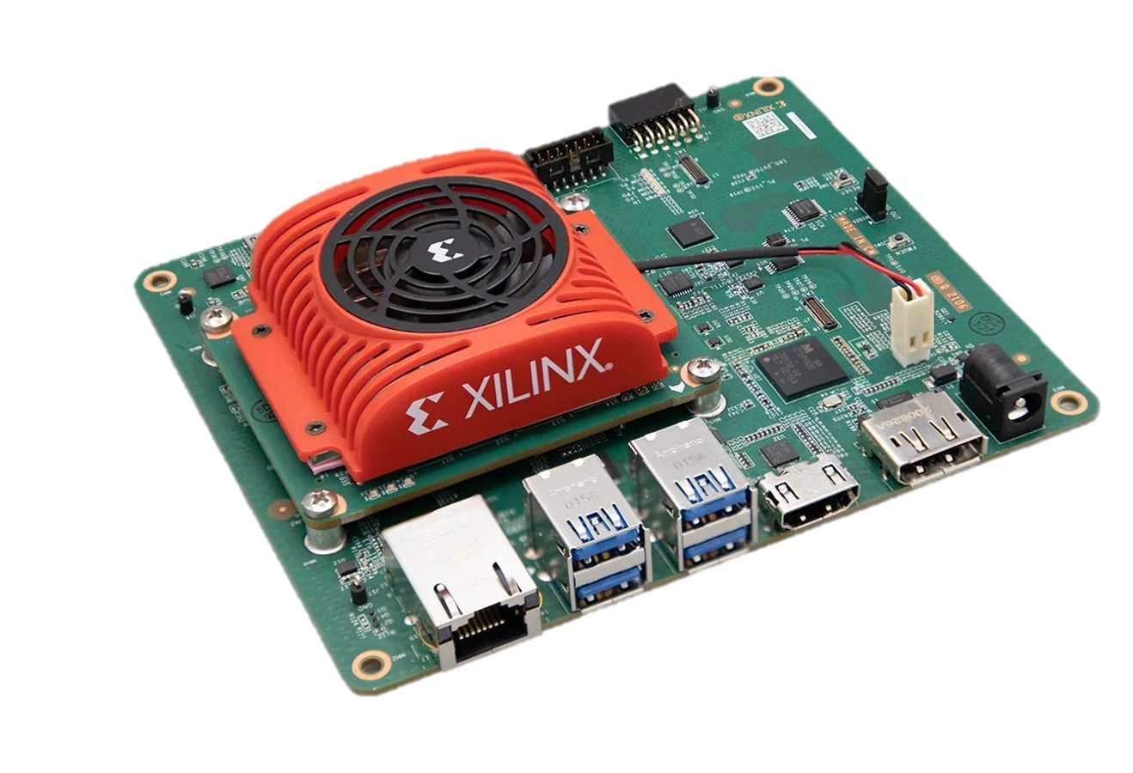
Project Overview
Expansion of a prior initiative and developed code base
Achieve the ability to simultaneously run three different algorithms/operations
Preprocessing
Blink Detection
Eye Tracking
Implement on a Xilinx Kria evaluation board
Using process and memory isolation techniques to achieve efficient and seamless operation
Notes:
Josh

Slide 3
Project Management - Agile
Flexibility and Adaptability
Our project has a lot of different solutions, being flexible allows us to reevaluate our implementations/decisions.
Milestone 1 (Set up)
Understand previous teams' work and try to recreate their products.
Meet with client to discuss the problem and possible solution
Milestone 2 (“4-week plan”)
Each member tries to fully understand respective roles.
Implement a program to put everything together, naively.
Analyze output and identify overheads.
Notes:
Jonathan

Slide 4
Task Decomposition
4
Notes:
Justin

Slide 5
Key milestones
Key Milestones | Evaluation Criteria
Understand previous team’s code. | Fully understand previous team’s code.
Combine image pre-processing, blink detection algorithm, eye-tracking algorithm, into one program (serially). | Fully implement and test each algorithm for accuracy.
Implement parallelism into program. | Achieve throughput of <5ms.
Implement semantic segmentation for image pre-processing and retrain model. | Achieve model accuracy of top-5 95% (while maintaining <5ms throughput).
5
Notes:
Kai

Slide 6
Risks and Mitigation Strategies
Risk | Mitigation Strategies
Not being able to complete project in time. | Check-in with each team member during the team meeting
Combining multiple algorithms into one program can increase the complexity of the software | Collaborative development
Implement parallelism into program could lead to synchronization overhead | Fine-Grained locking
Image semantic segmentation could take longer time | Add hardware accelerator to the current board, such as GPU or TPU
Not having enough time to complete project.
Table?
6
Notes:
Kai

Slide 7
Questions?
Notes:
Josh

