Slide 1
HAML: Heterogenous Computing for Machine Learning Algorithms
Santiago Campoverde, Jonathan Tan, Joshua Czarniak, Justin Wenzel, Kai Heng Gan
Team Id: sddec24-05
Client: JR Spidell
Advisor: Phillip Jones [E CPE]
Notes:
Everyone

Slide 2
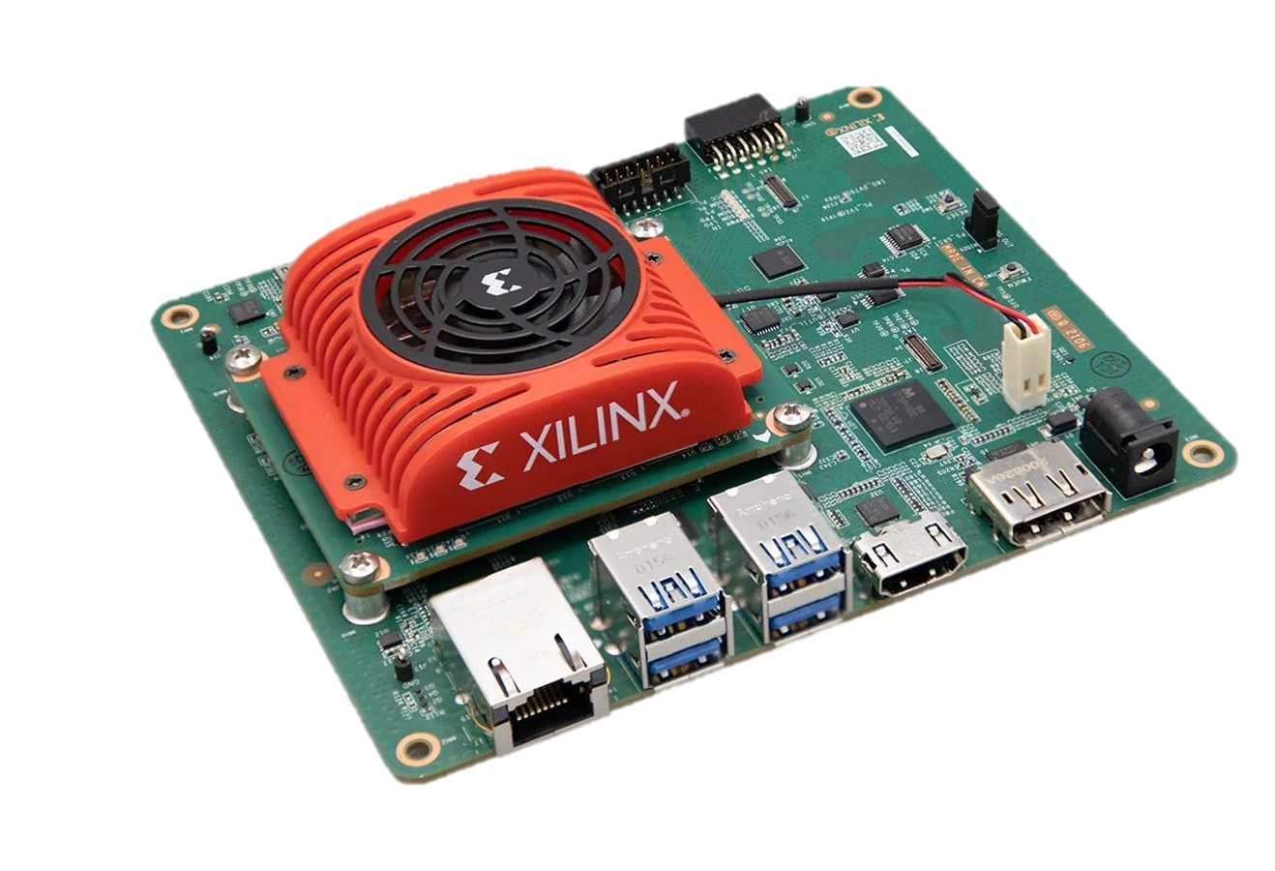
Project Overview
Expansion of a prior initiative and developed code base
Achieve the ability to simultaneously run three different algorithms/operations
Preprocessing
Blink Detection
Eye Tracking
Implement on a Xilinx Kria evaluation board
Using process and memory isolation techniques to achieve efficient and seamless operation
Notes:
Josh

Slide 3
Lotus Blossom Technique

Slide 4
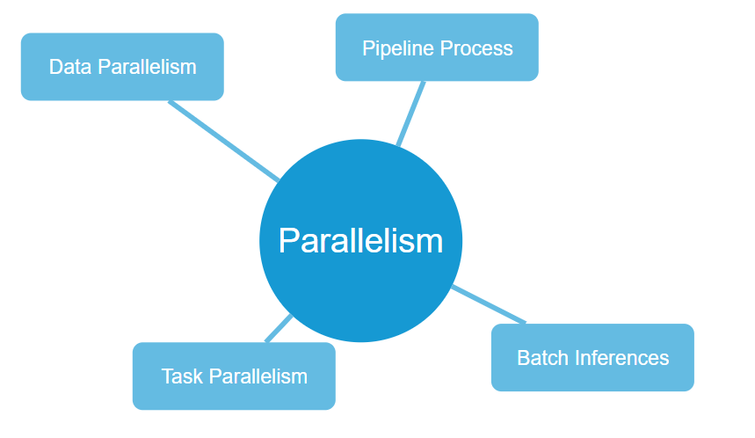
Potential Solution
Main Problem-
Meeting time requirements/FPS standards
Solution – Parallelism
Data Parallelism – Simultaneous data processing
Pipeline Processing – Sequential stages, parallel execution
Task Parallelism – Concurrent task execution
Batch Inferences – Grouped processing for efficiency
Benefits
Reduce processing time, enhance throughput, and improved performance

Slide 5
Market Research
Similar Capabilities
Working on AI driven eye tracking technology
Interested in eye tracking technology
Apparent Differences
Budget, Apple has significantly more budget and research capabilities compare to other two companies.
Different target audience [Eyeware and Tobii products are more focused on the gaming users, while Apple is more focused on professionals (e.g. developers) and well-heeled consumers user]

Slide 6
Questions?
Notes:
Josh

