Slide 1
HAML: Heterogenous Computing for Machine Learning Algorithms
Santiago Campoverde, Jonathan Tan, Joshua Czarniak, Justin Wenzel, Kai Heng Gan
Team Id: sddec24-05
Client: JR Spidell
Advisor: Phillip Jones [E CPE]
Notes:
Everyone

Slide 2
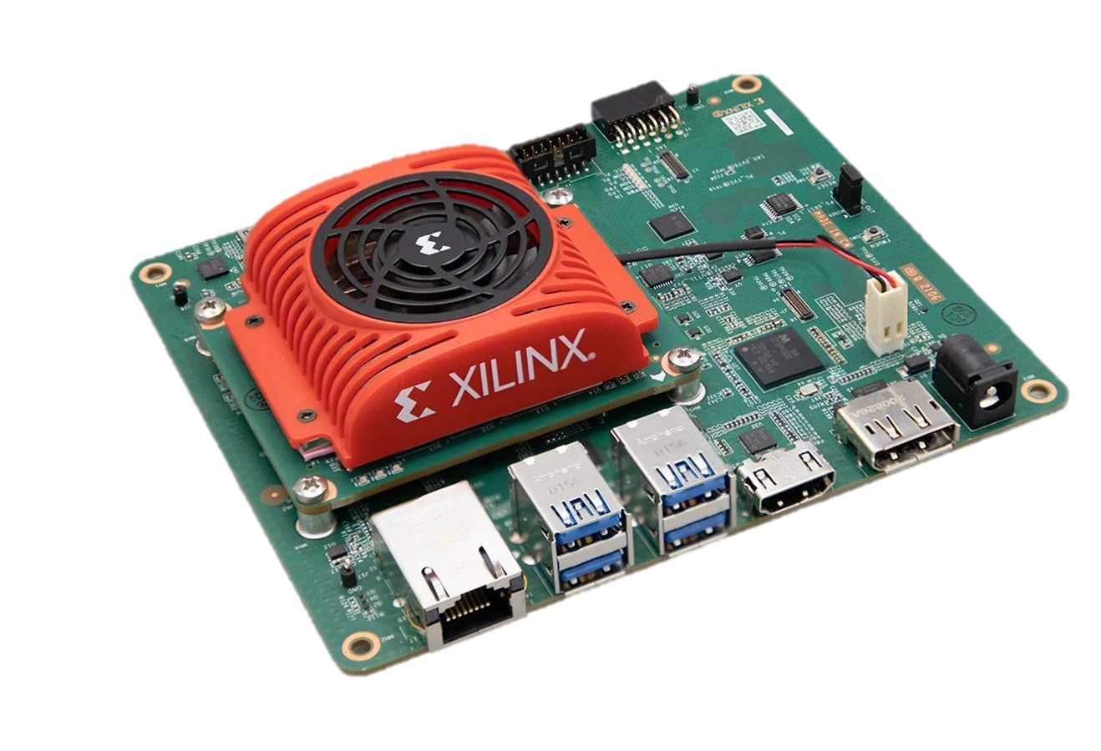
Project Overview
Expansion of a prior initiative and developed code base
Achieve the ability to simultaneously run three different algorithms/operations
Preprocessing
Blink Detection
Eye Tracking
Implement on a Xilinx Kria evaluation board
Using process and memory isolation techniques to achieve efficient and seamless operation
Notes:
Josh

Slide 3
Technical Design
OS/Profiling
Manage resources, profile system performance
Preprocessing
Semantic segmentation for image simplification
Machine Learning
Pupil Tracking – Produces X and Y coordinate of pupil
Blink – Produces a binary output indicating a blink or not occurred
Output
Produces out of machine learning algorithms for user
Memory Isolation
Isolated blocks of memory for easier memory management for threads

Slide 4
Functionality (Timeline)
Flow of User-System Interaction

Slide 5
Technology Considerations
Feature | NVIDIA JeTson Orin NX | Xilinx Kria KV260
Memory Management | 16GB or 8GB LPDDR5 (Low Power Double Data Rate) | 4GB DDR4 (Double Data Rate)
Speed (GPU/CPU) | Up to 1024 CUDA Cores, and 32 Tensor Cores | Zynq UltraScale+ MPSoC
Power | 10W to 25W (depends on 16GB or 8GB) adaptable modes | DC Input +12V, 3A, no details of power mode adaptability
Extra Features | Advanced security with dedicated controller, Platform Security Controller(PSC) | Encourages customization through Vitis and Vivado tools
Cost | $500 | $300

Slide 6
Concerns Within Development
Requirements and User Needs:
The design should meet specified performance benchmarks and user interface requirements, ensuring real-time processing and ease of use
Areas of Concern | Solutions and Mitigation | Design Alternatives
System Performance | Performance Testing | More Hardware Acceleration
User Interface | Usability Studies | Alternative UI Frameworks
Scalability | Modular Design Approach | Cloud Integration
Maintainability | Maintenance Plan | Adopt Continuous Integration and Development

Slide 7
Questions?
Notes:
Josh

