Slide 1
HAML: Heterogenous Computing for Machine Learning Algorithms
Santiago Campoverde, Jonathan Tan, Joshua Czarniak, Justin Wenzel, Kai Heng Gan
Team Id: sddec24-05
Client: JR Spidell
Advisor: Phillip Jones [E CPE]
Notes:
Everyone

Slide 2
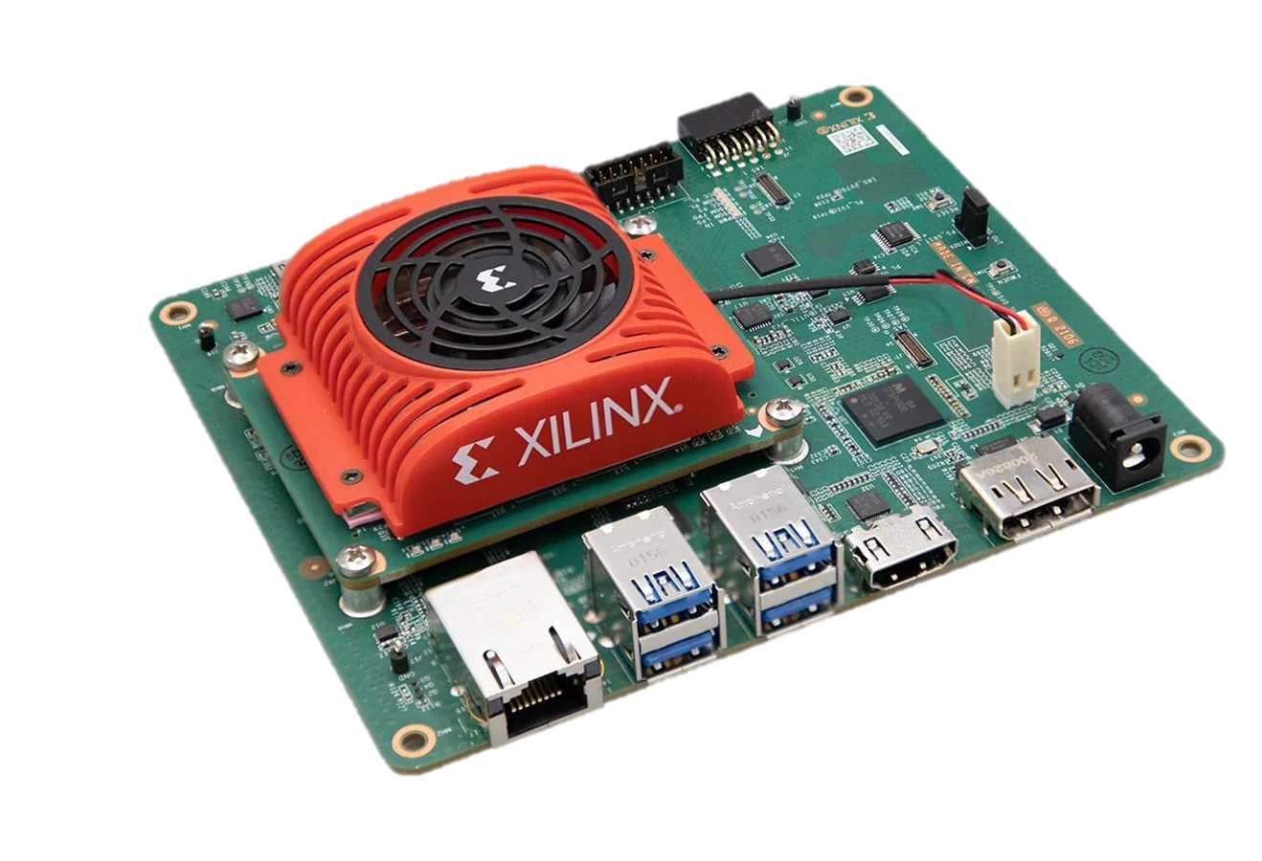
Project Overview
Expansion of a prior initiative and developed code base
Achieve the ability to simultaneously run three different algorithms/operations
Preprocessing
Blink Detection
Eye Tracking
Implement on a Xilinx Kria evaluation board
Using process and memory isolation techniques to achieve efficient and seamless operation
Notes:
Josh

Slide 3
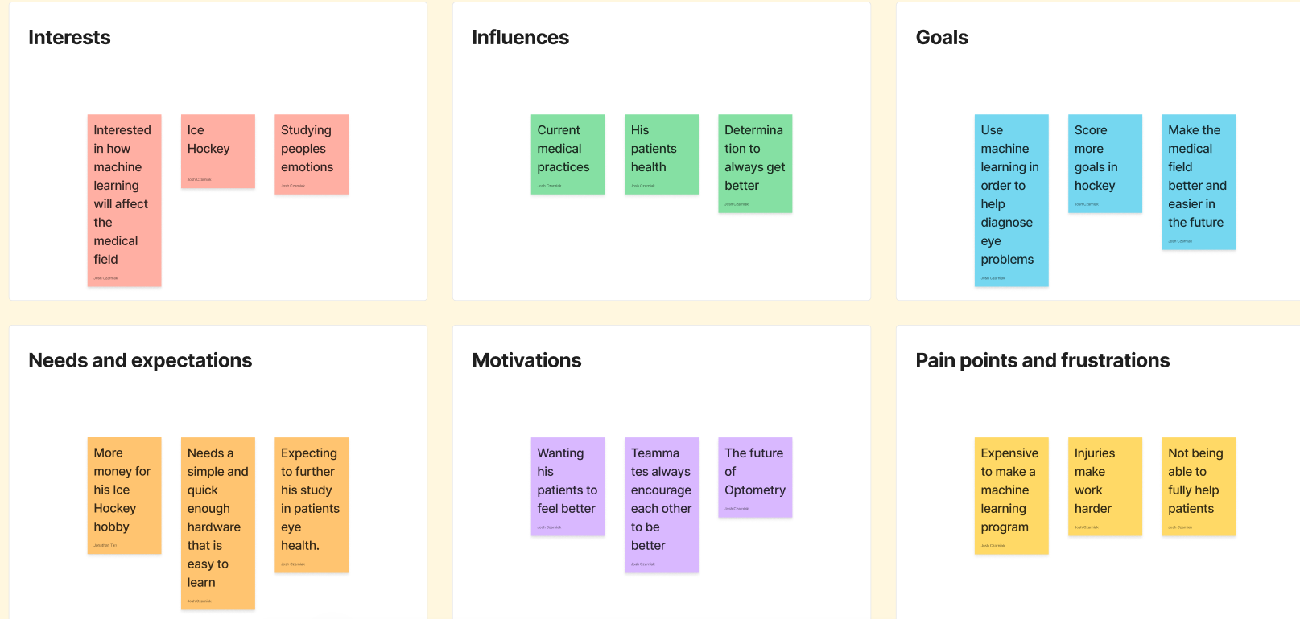
Human Artifact

Slide 4
Dr. Mark Johnson
User Needs
The algorithms can track eye and eyelid movement
Simple to operate the software
Can just tell the program to run
Cheaper side
Cost less for resources
Improvements
Running program on terminal
Implementation of a UI
Only tracks two movement of the eye
As an eye doctor may need to look at more

Slide 5
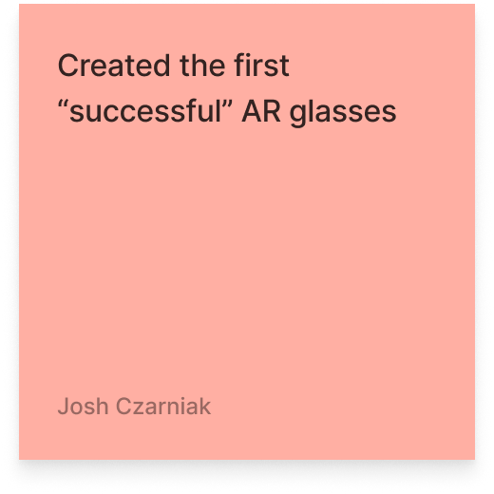
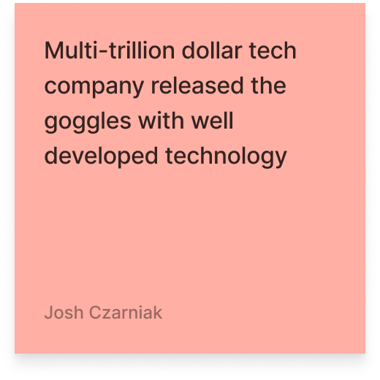
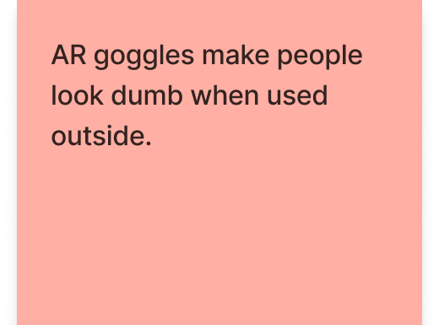
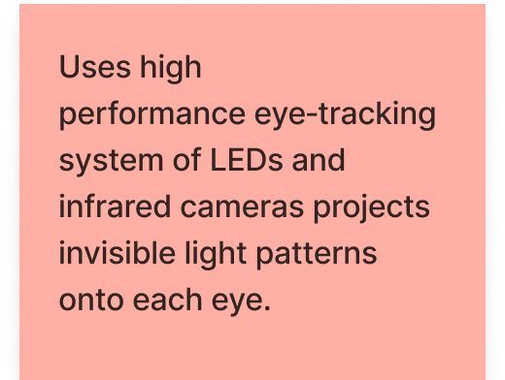
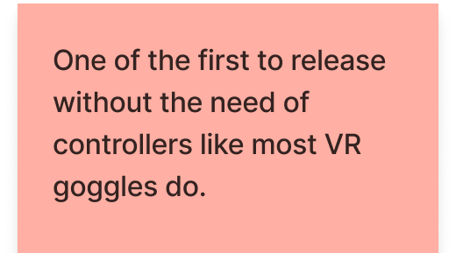
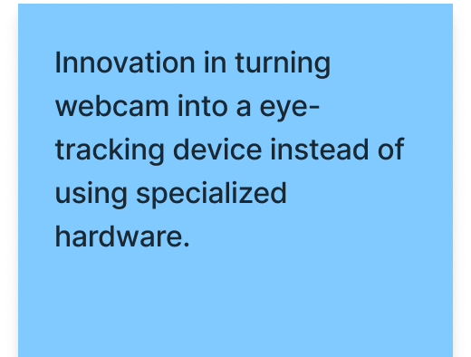
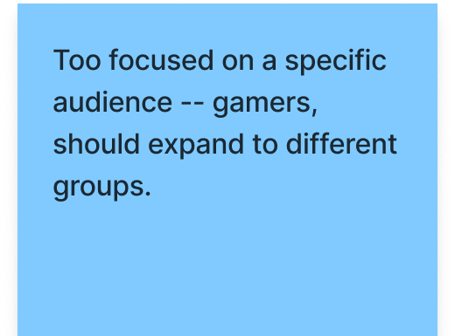
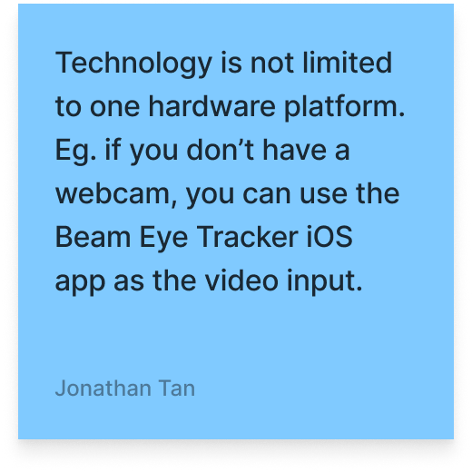
Economic Artifact
Eyeware | Apple
Unique Value Proposition | Company Advantages | Company Disadvantages

Slide 6
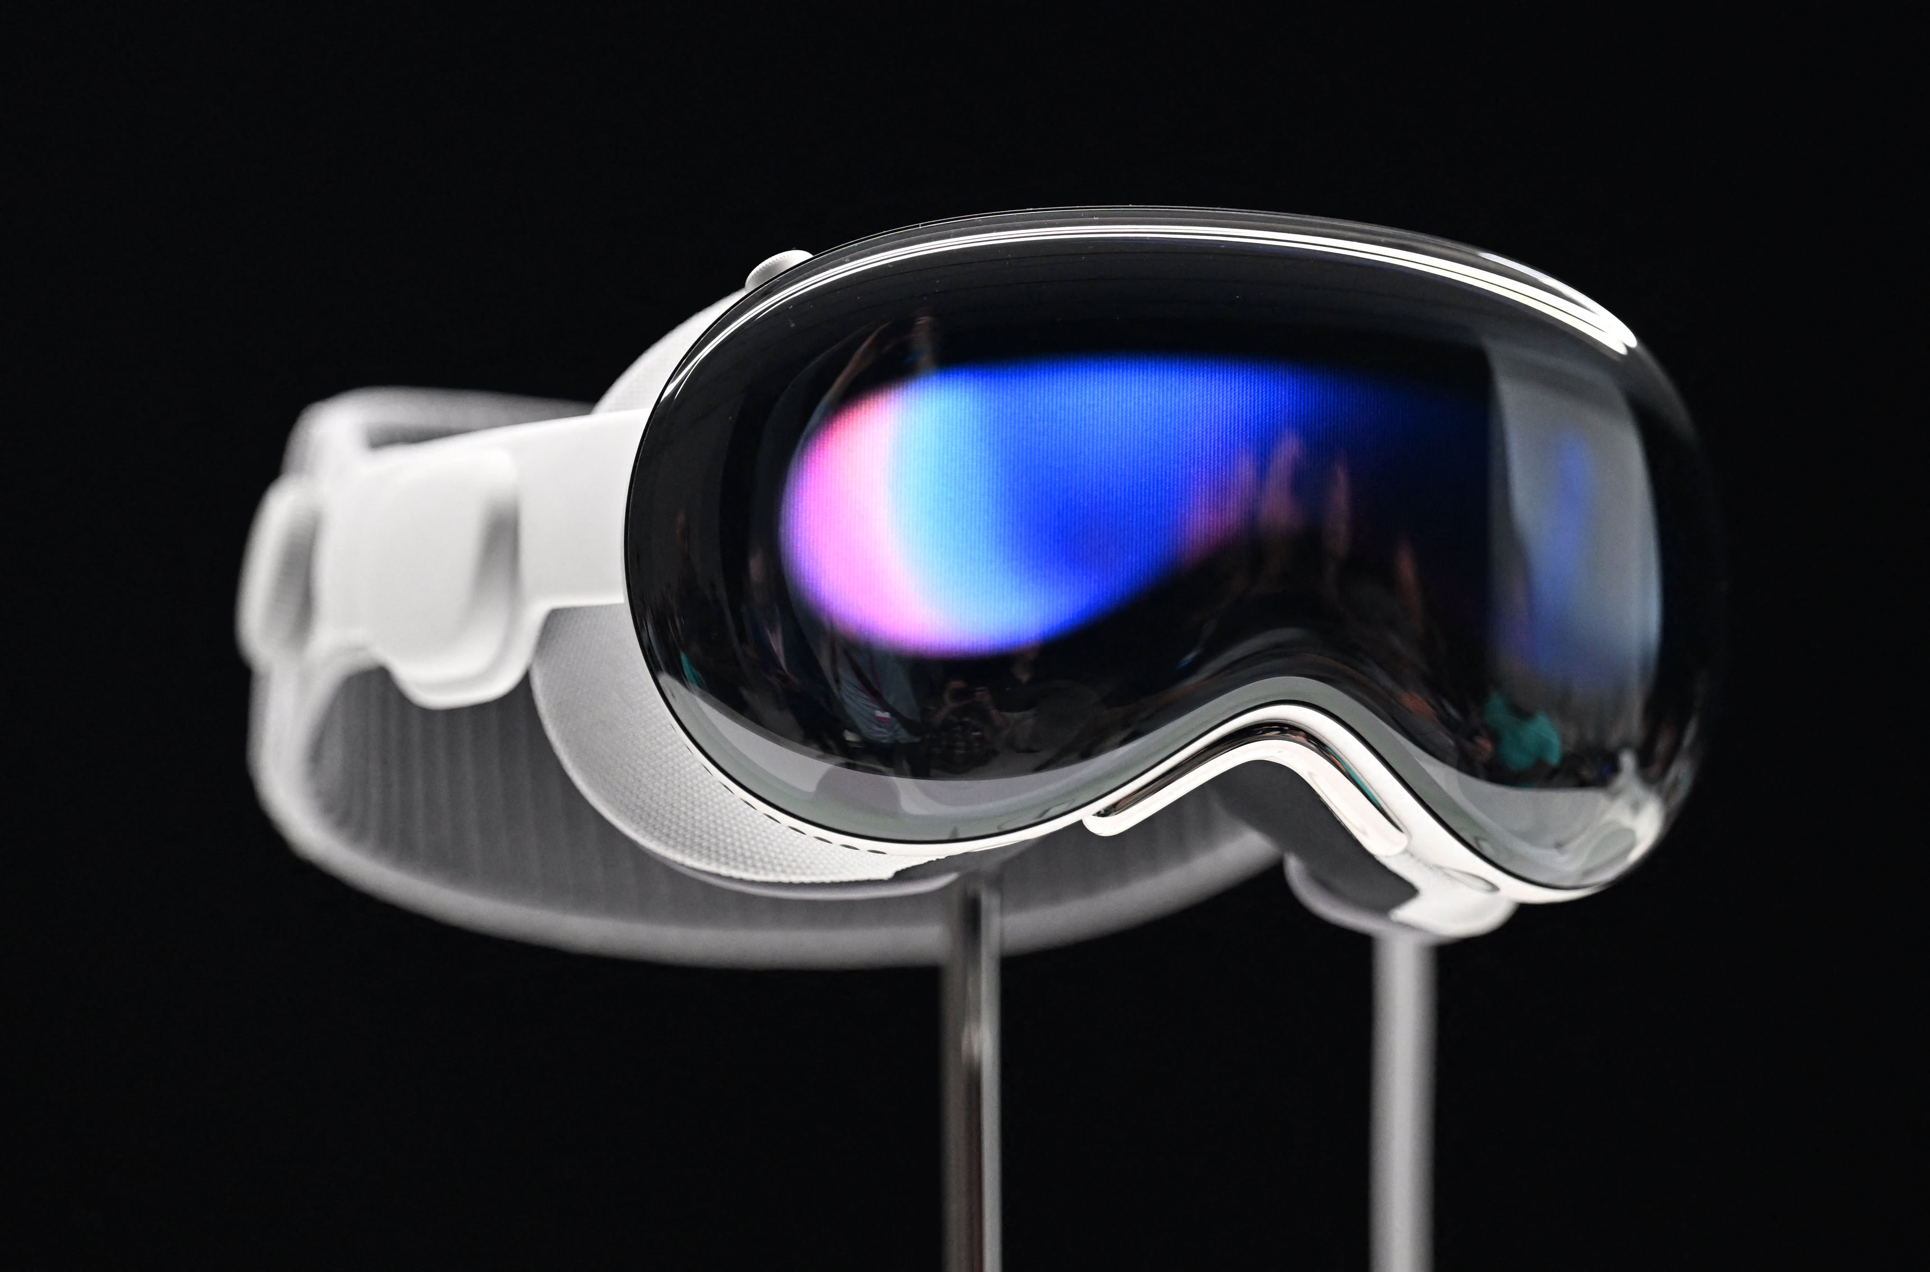
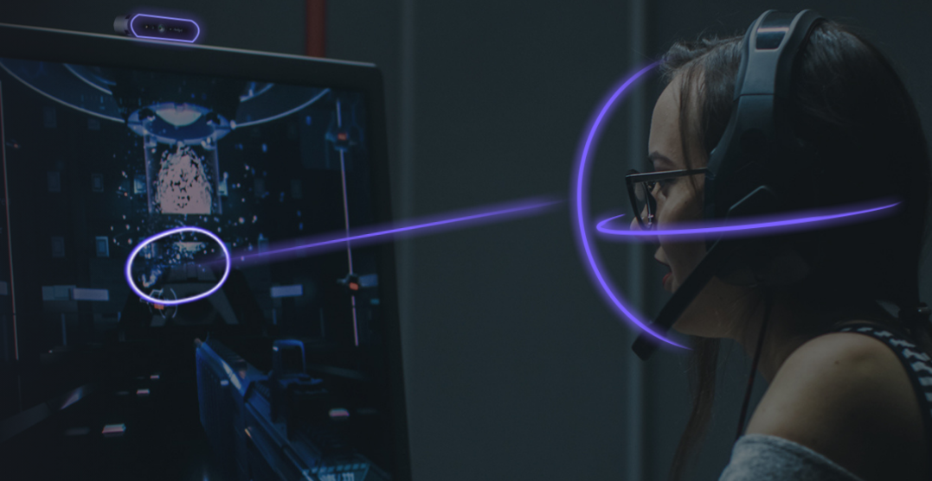
Economic
Other companies developing computer vision applications
Apple: Apple Vision Pro
Eyeware: Eye tracking software targeting gamers
Our solution aims to bridge many gaps:
Accessibility
Cost
Ease of use

Slide 7
Technical Artifact

Slide 8
Technical
Internal Complexity
Hardware integration
Memory management
Advanced image processing techniques
External Complexity
System integration
Performance optimization
Expertise showcase
Image processing: implement semantic segmentation to enhance the model accuracy
Hardware integration: Leveraging DPU to accelerate ML algorithms to achieve 200 fps
Concurrent task execution: Utilizing multi-threading to run multiple ML algorithm

Slide 9
Questions?
Notes:
Josh

